Slide 1


STL ALGORITHMS
Andrei Toader

Slide 2
STL Algorithms
Intent:
- A set of tools to improve expressiveness and correctness of the code.
- They avoid some common mistakes.
- https://en.cppreference.com/w/cpp/algorithm

Slide 3
STL Algorithms
Don’t use for_each for each problem…
This algorithm is effectively adapted when performing side effects.
If, for instance, you rather need to count the number of times a value is present is a collection, don’t use for_each. Use std::count.
If you need to know if there is at least one element satisfying a predicate in your collection don’t use for_each. Use std::any_of.
If you need to know whether all the elements of a collection satisfy a given predicate, use std::all_of.

Slide 4
STL Algorithms
std::copy

Slide 5
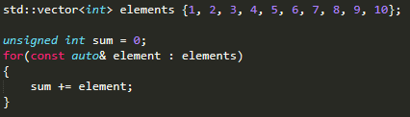

STL Algorithms
std::accumulate

Slide 6
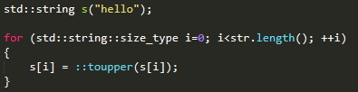
STL Algorithms
std::transform

Slide 7
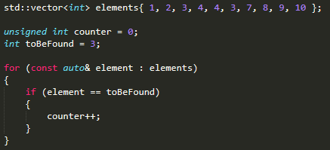

STL Algorithms
std::count

Slide 8
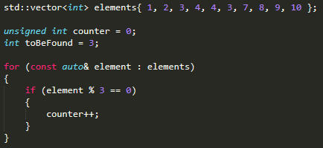

STL Algorithms
std::count_if

Slide 9
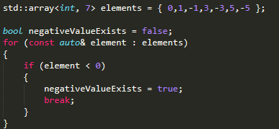
STL Algorithms
std::any_of

Slide 10
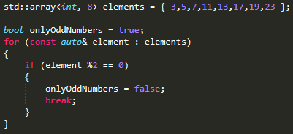
STL Algorithms
std::all_of

Slide 11
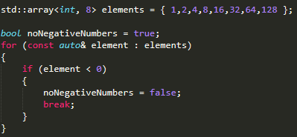
STL Algorithms
std::none_of

Slide 12
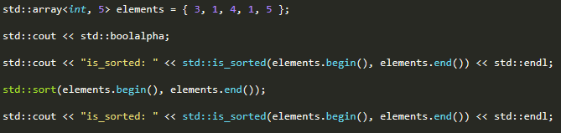
STL Algorithms
std::sort and std::is_sorted

Slide 13
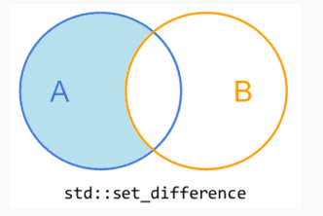
STL Algorithms
std::set_difference
With a sorted collection A and a sorted collection B, set_difference outputs the elements in A that are not present in B

Slide 14
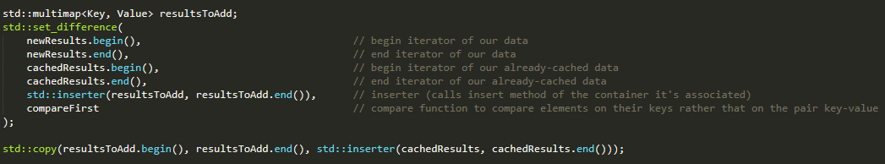
STL Algorithms
std::set_difference
Example:
- Add to the cache the elements that are in the results, but do not exist in the cache.

Slide 15
THANK YOU

